Slide 1

Week 8
Behram Khan

Slide 2
Game Design

Slide 3
Game Design
Game design is the deliberate creation of rules, systems, and player experiences.
A game designer deciding the player experience.
The core question it involves is what does the player actually do and feel in every minute of the game.
Does not involve programming, arts, marketing.
Key distinction: A game designer decides how the game works. A programmer implements it. An artist makes it look good. A producer manages the team. All are important, but design is about the interactive experience itself.
Notes:
STR: Store a value to memory.
ADD: Add two values.
SUB: Subtract one value from another.
MOV: Move data from one location to another.

Slide 4
MDA Framework
Mechanics: The systems built by the designer. Anything the player can do in the game.
Dynamics: The emergent behaviors that happen when players interact with mechanics
Aesthetics: The emotional responses the game evokes in players.
Example:
PUBG: M -> Guns, health
D -> Camping, rushing
A -> Tension, fear
Plants vs Zombies:
Notes:
STR: Store a value to memory.
ADD: Add two values.
SUB: Subtract one value from another.
MOV: Move data from one location to another.

Slide 5
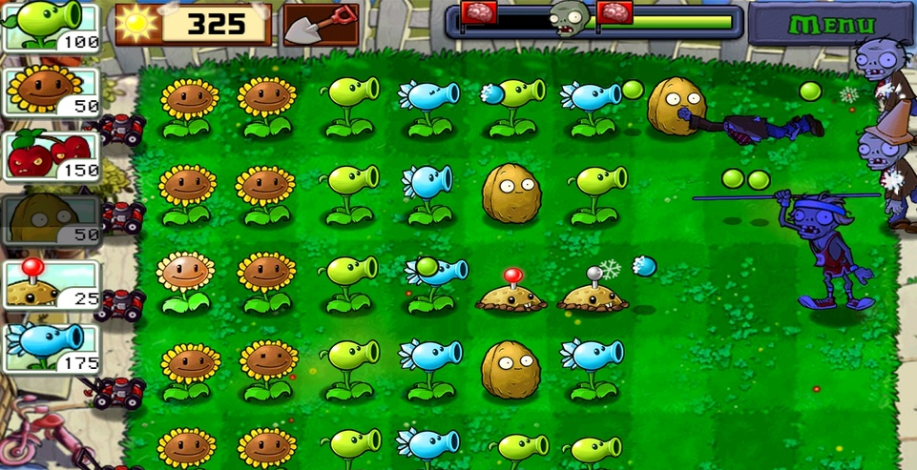

Slide 6
Game design principles
Clarity – The player always understands what just happened. They know why they took damage, why a door opened, why they failed.
Consistency – Same input produces the same output (unless randomness is explicitly part of the design). If jump works one way in level 1, it should work the same way in level 8. Anti-pattern: Jump distance changes depending on which platform you're on.
Feedback – Every player action has a response. Even doing nothing (idle animation) is feedback that the game is still running. Anti-pattern: Pressing a button and nothing happens for 0.5 seconds.
Fairness – Player skill (or strategic choice) determines outcome more than random chance. When randomness exists, the player should understand the odds. Anti-pattern: Unavoidable damage, invisible traps, AI that reads your inputs.
Meaningful Choices – Two or more options with real trade-offs, where neither is obviously better. The choice should matter to the outcome. Anti-pattern: Both paths lead to the same reward, one weapon is statistically superior in all situations.
Learnability – The game is easy to start (low barrier) but offers depth for mastery. The first 10 minutes teach core mechanics without a manual. Anti-pattern: A steep learning curve from minute one, requiring external wiki to understand basics.
Notes:
STR: Store a value to memory.
ADD: Add two values.
SUB: Subtract one value from another.
MOV: Move data from one location to another.

Slide 7
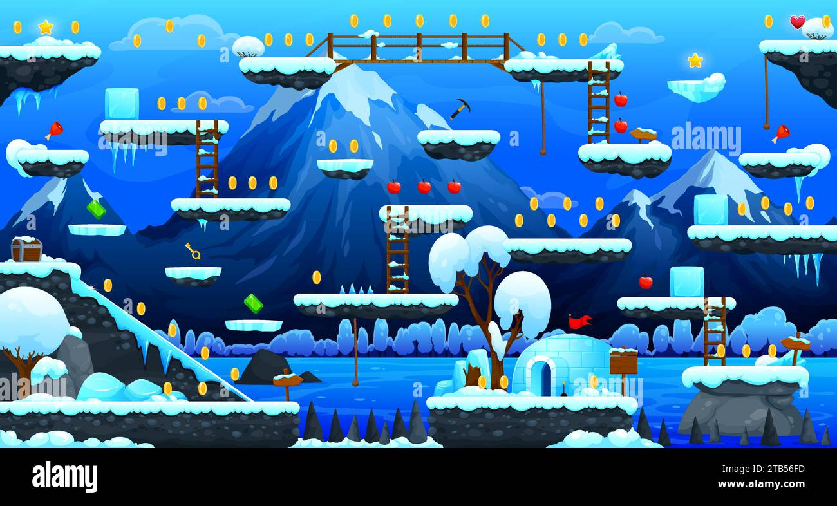

Slide 8


Slide 9
The player experience
Thinking About the User (Player-Centered Design)
You are not designing for yourself. You are designing for a player with different skills, patience, and goals.
Player personas (based on Bartle's Taxonomy, adapted for all games):
• Achievers – Want points, levels, 100% completion, trophies. They play to win and collect.
• Explorers – Want to understand the world, find secrets, map systems. They play to discover.
• Socializers – Want to talk, roleplay, help others, form guilds. They play to connect.
• Killers – Want to dominate, compete, be the top of the leaderboard. They play to defeat others.
Notes:
STR: Store a value to memory.
ADD: Add two values.
SUB: Subtract one value from another.
MOV: Move data from one location to another.

Slide 10
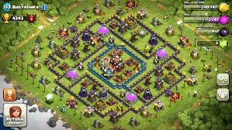

Slide 11
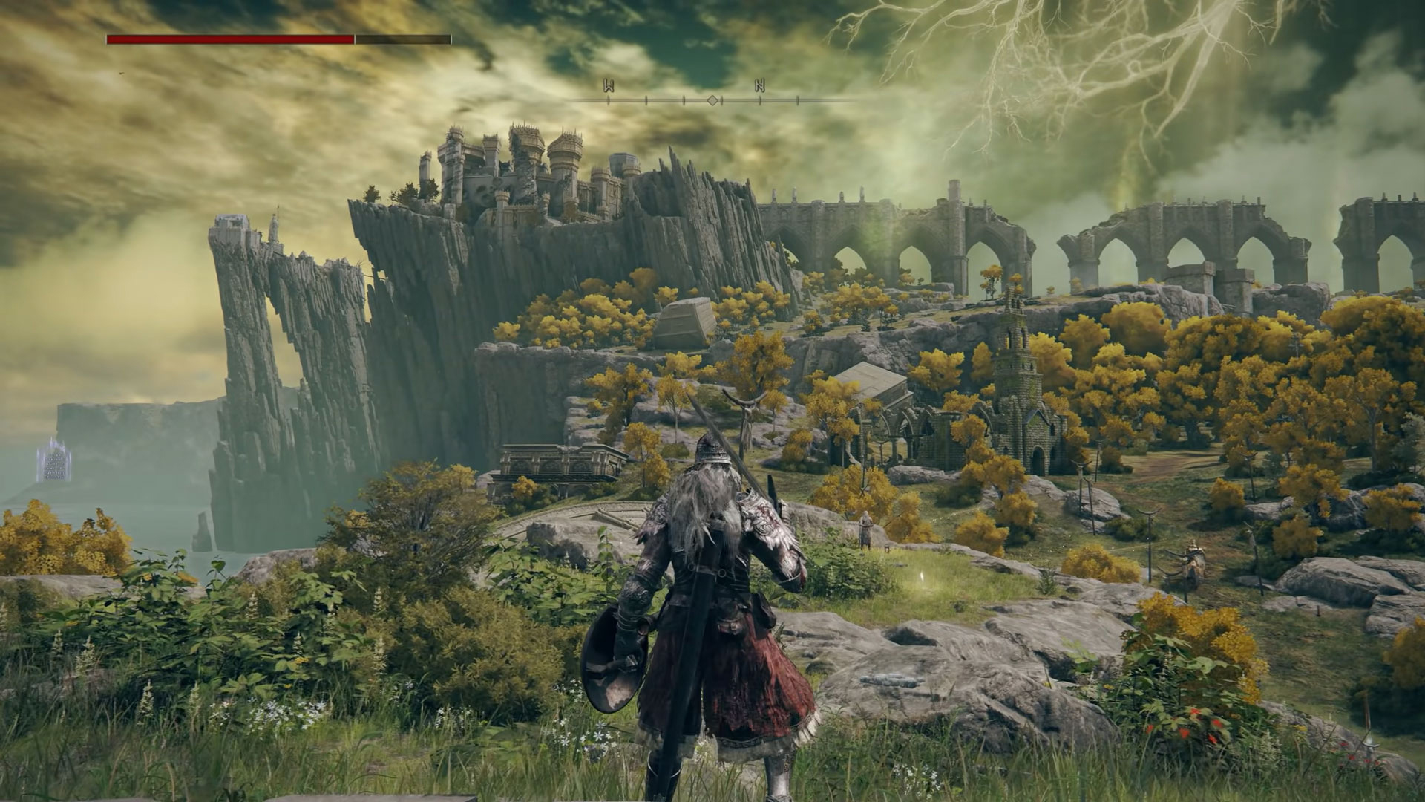

Slide 12
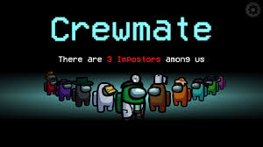

Slide 13
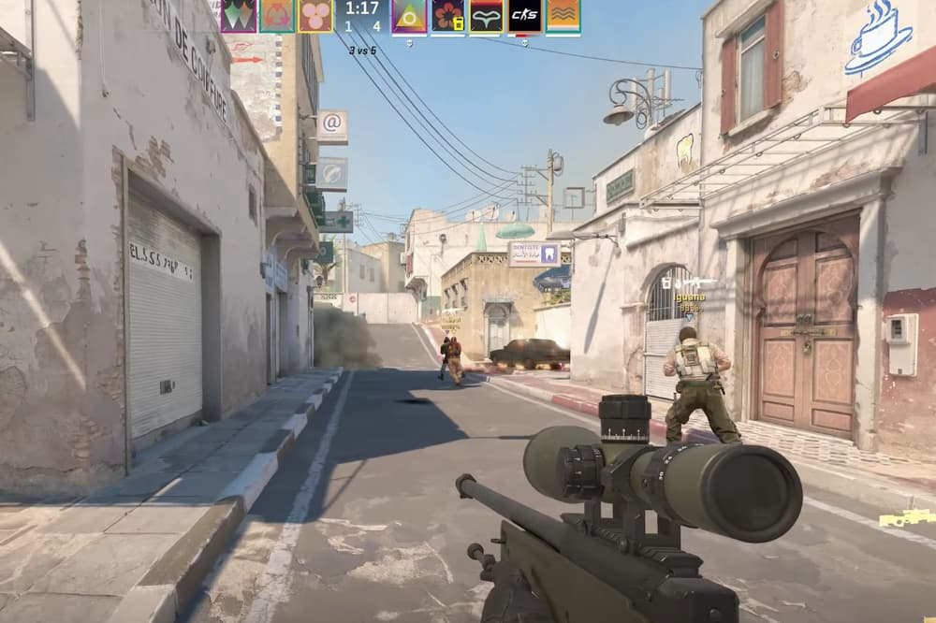

Slide 14
Player Motivation
Players are motivated by psychological needs that games can satisfy.
Autonomy: Freedom to choose what to do, when, and how, Minecraft, Breath of the Wild, Skyrim
Mastery: Getting better at a skill over time, visible improvement, Dark Souls, fighting games, rhythm games
Purpose: Having a meaningful impact on the game world or other players, Papers, Please, This War of Mine, MMO healing.
What doesn't work: Games that only punish (no reward), only grind (no mastery), only force social play (introverts quit), or only offer meaningless choices.
Notes:
STR: Store a value to memory.
ADD: Add two values.
SUB: Subtract one value from another.
MOV: Move data from one location to another.

Slide 15
Feedback
Feedback is how the game talks back to the player. Without feedback, the player feels like they are pressing buttons into a void. Feedback happens at multiple time scales.
Audio/visual : coin sounds, hit flash. Satisfaction
Animation response: Character pushes back.
Progression Feedback: Unlock new abilities, character levelups, new items found.
• Street Fighter: Hit spark, screen freeze, health bar drains, announcer says "K.O.!", crowd cheers.All within 0.3 seconds.
• Mario: Jumping has a squash/stretch animation, coin collection has a rising chime, landing on an enemy has a distinct "boop" and bounce.
• Portal: Placing a portal has a distinct "thwump" sound, traveling through has a whoosh, and the destination portal shows the new view immediately.
Notes:
STR: Store a value to memory.
ADD: Add two values.
SUB: Subtract one value from another.
MOV: Move data from one location to another.

Slide 16
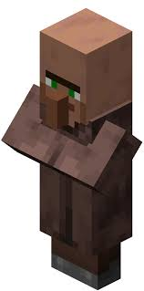
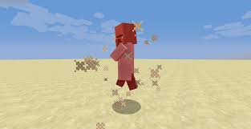

Slide 17
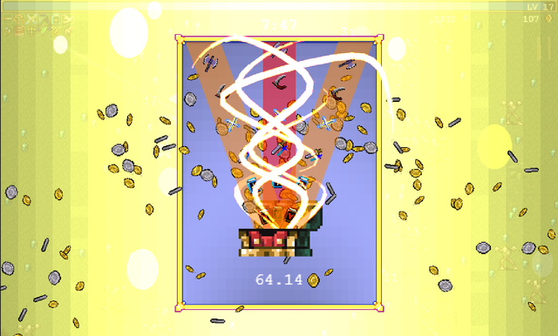

Slide 18
Game Feel
The moment-to-moment sensations of the game, what makes a jump feel right, a car feels heavy, shooting feeling good. Not necessary for functionality but must of delight.
Examples of juice:
• Screen shake when something explodes
• Particles flying from a collected item
• A slight delay before a big explosion (anticipation)
• Squash and stretch on a character's jump
• Controller rumble on impact
• A satisfying thud sound when landing from a height
• Flashing UI numbers when dealing damage
Notes:
STR: Store a value to memory.
ADD: Add two values.
SUB: Subtract one value from another.
MOV: Move data from one location to another.

